Slide 1
SOCIAL MEDIA ANALYSIS
By :Kushal Chowdary A S

Slide 2
About META:
Meta is a global technology company that owns platforms like Facebook, Instagram, and WhatsApp, with a mission to give people the power to build community and bring the world closer together through innovative and immersive digital experiences.

Slide 3
01
02
Problem Statement
Data Description.
03
04
Objective Key Metrics and Visualizations
Conclusion
Agenda

Slide 4

Problem Statement
You are hired as a data analyst at Meta and asked to collaborate with Marketing team. Marketing teams wants to leverage Instagram's user data to develop targeted marketing strategies that will increase user engagement, retention, and acquisition. Provide insights and recommendations to address the following objectives.

Slide 5
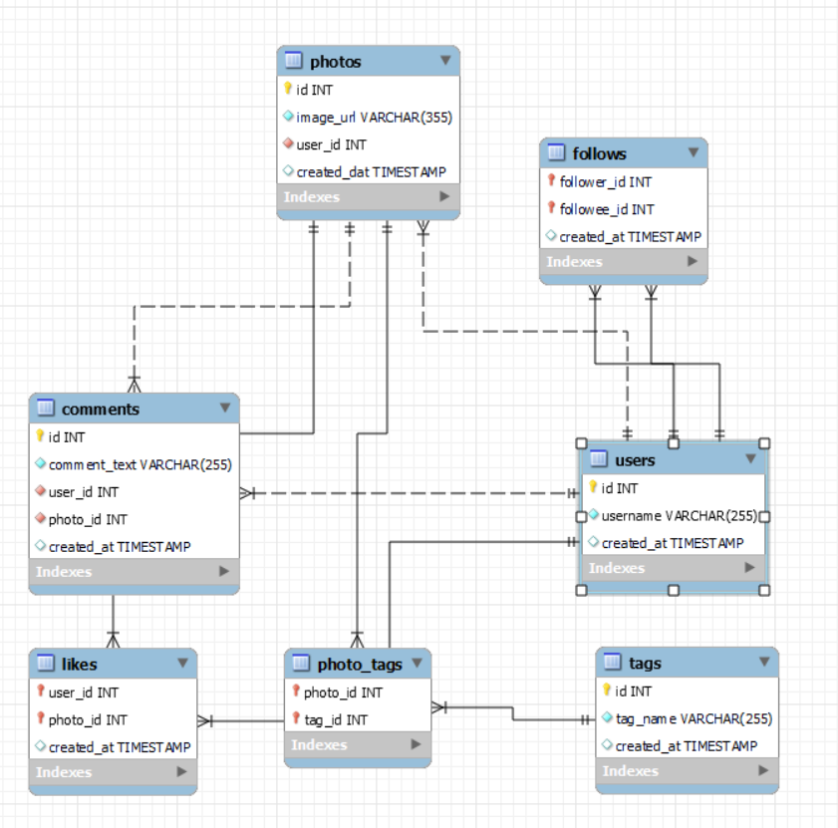
Database schema

Slide 6
DATA DESCRIPTION
The dataset contains information 7 tables. Below is an overview of the dataset:
Users Table : information about users registered on the platform
Photos Table: information about the photos uploaded by users.
Comments Table: Stores all comments made by users on photos.
Likes Table: Tracks which users liked which photos.
Follows Table: Tracks user relationships (followers and followees).
Tags Table: Stores unique tags that are associated with photos.
Photo_Tags Table: connects photos with tags.

Slide 7
User Activity Levels:
Zero Posts: 30% of users are inactive content creators.
Low Posts (1–4): 60% of users are minimal content creators.
Medium Posts (5–9): 25% show moderate content creation.
High Posts (10+): Small fraction but highly active users.

Slide 8
User Activity Levels:
High Likes: 13 users – A small but highly engaged group with significant interaction.
Medium Likes: 31 users – A moderate number of users receiving an average level of likes.
Low Likes: 33 users – The largest group, suggesting a need for strategies to enhance their engagement.
Zero Likes: 23 users – A notable portion of users who are receiving no likes, indicating a potential opportunity for re-engagement or content optimization."

Slide 9
User Activity Levels:
High Comments: 13 users – A small but highly engaged group actively participating in conversations.
Low Comments: 64 users – The largest segment, indicating that most users engage minimally in commenting.
Zero Comments: 23 users – A significant portion of users who are not engaging in comments at all, suggesting an opportunity for increased interaction."

Slide 10
Distribution of Popular Tags
"From our analysis of the most frequently used tags, we observe the following distribution:
Party: 20 occurrences – The most popular tag, showing a strong association with celebration and social events.
Beauty, Fashion, Food, Foodie: 8 occurrences each – These tags suggest high user engagement around lifestyle, aesthetics, and food-related content.
Beach, Concert, Fun: 6 occurrences each – Tags related to leisure activities, events, and outdoor experiences.
Smile, Photography: 5 occurrences each – Popular tags tied to emotions and visual storytelling.
Delicious, Dreamy, Drunk, Happy, Style, Sunrise, Sunset: 4 occurrences each – Diverse tags reflecting different aspects of lifestyle, emotions, and nature.
.
Hair, Landscape, LOL, Stunning: 3 occurrences each – Niche tags linked to beauty, nature, and humor.
Foodie, Landscape: 2 occurrences each – Specific tags with lower but notable usage."

Slide 11
Engagement Strategies
For Inactive Users:Target zero-post users with content creation challenges, incentives, or tutorials to encourage engagement.
For Low-Engagement Users:Run campaigns that incentivize comments, likes, and sharing (e.g., giveaways, Q&A, polls).
For Active Users:Foster UGC (User-Generated Content) by highlighting frequent contributors and creating collaboration opportunities.

Slide 12
Retention Strategies
Personalized Content:
Use AI and data analytics to show content based on previous interactions (posts, likes, comments).
Re-engagement Campaigns:
Retarget users who have gone inactive with reminders, rewards, or exclusive content.
Incentivize Consistent Activity:
Offer rewards for consistent posting and engagement (e.g., badges, early access to features).

Slide 13
Acquisition Strategies:
Influencer Marketing:
Collaborate with highly active users (high posts, likes) to reach a larger audience.
Referral Programs:
Implement referral programs where active users can bring new, engaged users to the platform.
Target Zero-Post Users:
Run introductory campaigns to guide zero-post users into content creation with incentives.

Slide 14
Data-Driven Decision Making
Utilize Instagram Analytics:
Regularly track and monitor user activity trends to adjust marketing strategies in real time.
A/B Testing:
Test different content formats (stories, posts, reels) and promotions to see which works best for various user segments

Slide 15
Conclusion & Key Recommendations
Key Takeaways:
Focus on encouraging content creation among inactive users.
Engage low-activity users with interactive campaigns.
Leverage highly active users for brand promotion and acquisition.
Actionable Next Steps:
Execute campaigns for zero-post users.
Create personalized content experiences.
Partner with influencers to reach wider audiences.

Slide 16
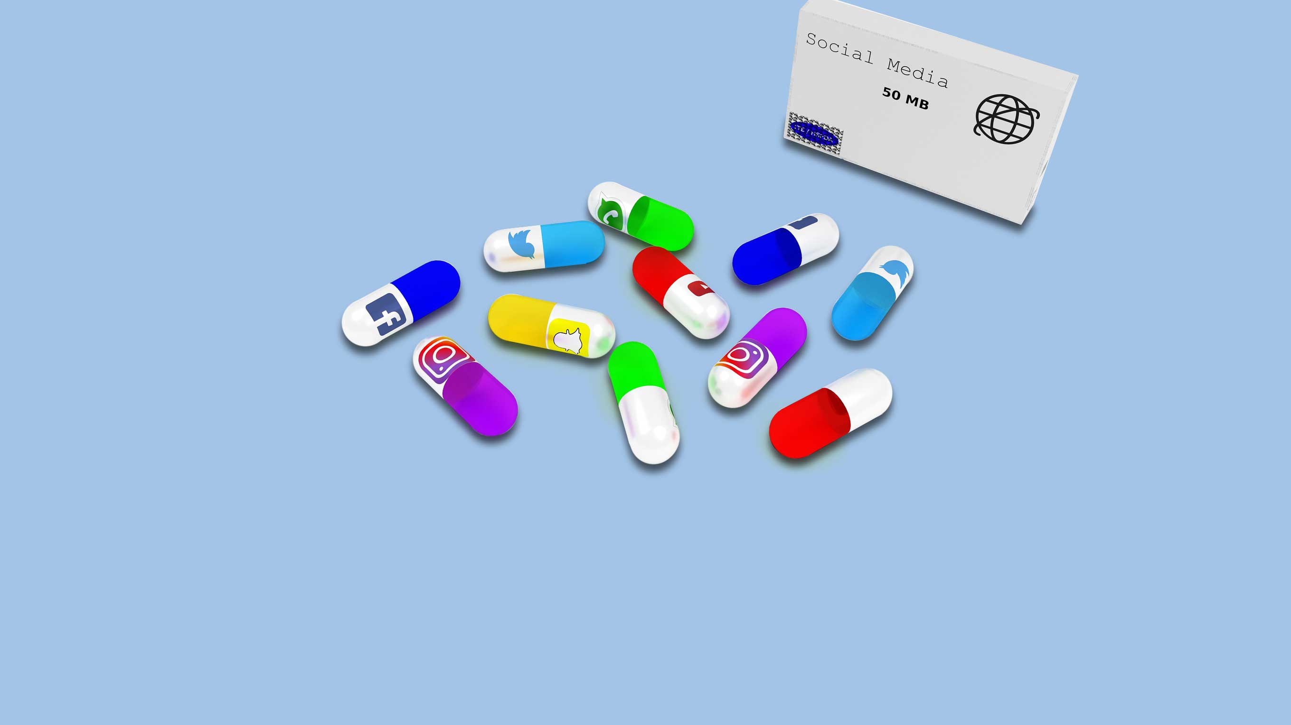
THANK YOU

